Slide 1

Face Mask wear detection
Shashank Singh

Slide 2
Objective:
The solution proposed here is a face make wear detection-based surveillance can prevent from above mention cases, if any person who don’t wear a mask, then the person monitoring or police or any public safety department can take action immediately.

Slide 3
Benefits:
To detect whether person wear mask or not to get prevent from this virus.
To examine that all person can contribute to make this pandemic away.
To stop the spreading virus to an unknown person who itself don’t know that the person itself affected.
In hospital and all public place where chance to get affected by covid19 virus
Keep pandemic under control.

Slide 4
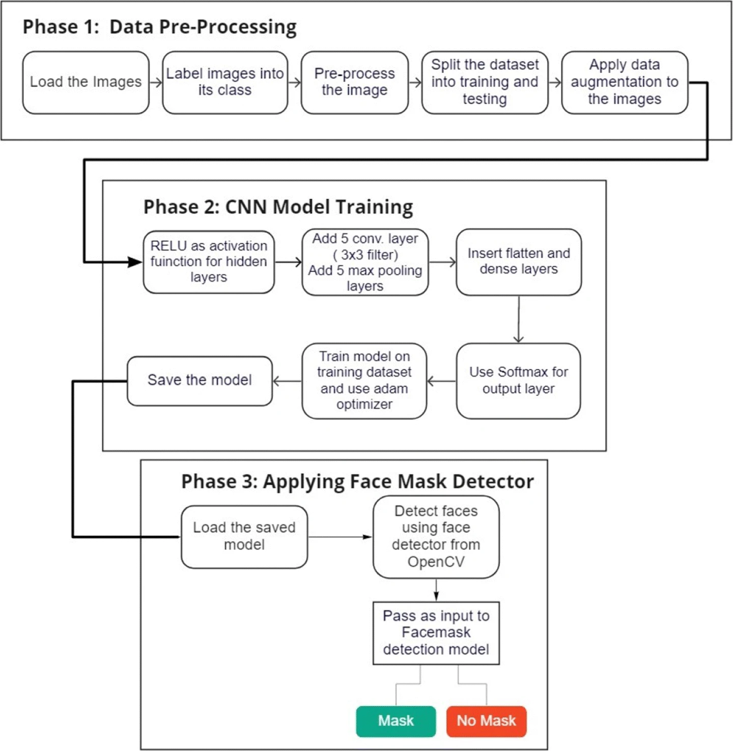
Architecture

Slide 5
Data Processing
Data preprocessing involves conversion of data from a given format to much more user friendly, desired and meaningful format. It can be in any form like tables, images, videos, graphs, etc. These organized information fit in with an information model or composition and captures relationship between different entities . The proposed method deals with image and video data using Numpy and OpenCV.

Slide 6
Data Visualization
Data visualization is the process of transforming abstract data to meaningful representations using knowledge communication and insight discovery through encodings. It is helpful to study a particular pattern in the dataset .
The total number of images in the dataset is visualized in both categories – ‘with mask’ and ‘without mask’.
The statement categories=os.listdir(data_path) categorizes the list of directories in the specified data path. The variable categories now looks like: [‘with mask’, ‘without mask’]
Then to find the number of labels, we need to distinguish those categories using labels=[i for i in range(len(categories))]. It sets the labels as: [0, 1]

Slide 7
Conversion of RGB image to Gray image
Modern descriptor-based image recognition systems regularly work on grayscale images, without elaborating the method used to convert from color-to-grayscale. This is because the color-to-grayscale method is of little consequence when using robust descriptors. Introducing nonessential information could increase the size of training data required to achieve good performance. As grayscale rationalizes the algorithm and diminishes the computational requisites, it is utilized for extracting descriptors instead of working on color images instantaneously.
the function cv2.cvtColor(input_image, flag) for changing the color space. Here flag determines the type of conversion . In this case, the flag cv2.COLOR_BGR2GRAY is used for gray conversion.
Deep CNNs require a fixed-size input image. Therefore we need a fixed common size for all the images in the dataset. Using cv2.resize() the gray scale image is resized into 100 x 100.

Slide 8
Image Reshaping
The input during relegation of an image is a three-dimensional tensor, where each channel has a prominent unique pixel. All the images must have identically tantamount size corresponding to 3D feature tensor. However, neither images are customarily coextensive nor their corresponding feature tensors [10]. Most CNNs can only accept fine-tuned images. This engenders several problems throughout data collection and implementation of model. However, reconfiguring the input images before augmenting them into the network can help to surmount this constraint.

Slide 9
Training of model
a) Building the model using CNN architecture
CNN has become ascendant in miscellaneous computer vision tasks . The current method makes use of Sequential CNN.
The First Convolution layer is followed by Rectified Linear Unit (ReLU) and MaxPooling layers. The Convolution layer learns from 200 filters. Kernel size is set to 3 x 3 which specifies the height and width of the 2D convolution window. As the model should be aware of the shape of the input expected, the first layer in the model needs to be provided with information about input shape. Following layers can perform instinctive shape reckoning . In this case, input_shape is specified as data.shape[1:] which returns the dimensions of the data array from index 1. Default padding is “valid” where the spatial dimensions are sanctioned to truncate and the input volume is non-zero padded. The activation parameter to the Conv2D class is set as “relu”. It represents an approximately linear function that possesses all the assets of linear models that can easily be optimized with gradient-descent methods. Considering the performance and generalization in deep learning, it is better compared to other activation functions . Max Pooling is used to reduce the spatial dimensions of the output volume. Pool_size is set to 3 x 3 and the resulting output has a shape (number of rows or columns) of: shape_of_output = (input_shape – pool_size + 1) / strides), where strides has default value (1,1) .

Slide 10
Splitting the data and training the CNN model
After setting the blueprint to analyze the data, the model needs to be trained using a specific dataset and then to be tested against a different dataset. A proper model and optimized train_test_split help to produce accurate results while making a prediction. The test_size is set to 0.1 i.e. 90% data of the dataset undergoes training and the rest 10% goes for testing purposes. The validation loss is monitored using ModelCheckpoint. Next, the images in the training set and the test set are fitted to the Sequential model. Here, 20% of the training data is used as validation data.

Slide 11
Prediction
System is display option for image masked face detection or real time face mask detection.
The User chooses the target disease by clicking one of the available.
The user gives required information.
The system should able to predict whether the ( image, video ) wear a mask.

